Slide 1
Robot Project Meeting 9 – 19/12/2018
Bourgogne, Colrat, Evaux, Gaizi, Nicolle – ACE TEAM
Chenaud - PTE

Slide 2
Last Meeting
These were the points discussed
Bastien Chenaud (PTE department) is working on an android app to control the robot with a joystick. He is contributing to the project as an external contributor
Finding a way of highlighting the AURIX and remove the raspberry from the top of the robot
Organisation of the trip to Nuremberg for Embedded World
To be done
Find a longer cable for the Camera -> New Equipment order
Nuremberg Organisation: PowerPoint presentation – done
Add Infineon Logo to the GUI – Partly done

Slide 3
Bastien: Android App for Remote Control via Bluetooth
Specifications : Being able to control the robot using a joystick in an Android App (via Bluetooth Communication).
Use of Android Studio (java and xml). Software needed to get the numerous android libraries for objects and interfaces.
Submodules:
1st sub-module: the joystick object. Can move in a circle with a radius of 1 and return x and y value. (Default position in 0;0)
2nd sub-modules: Textboxes are generated to give :
the x position of the Joystick
the y position of the Joystick
the Bluetooth states (On/Off/Turning On/Turning Off)
3rd sub-module: A spinner (=drop down menu) is generated to show the list of paired devices available for Bluetooth connection
4th sub-module: The creation of the Bluetooth communication by the recovery of the remote device information and the socket implementation.

Slide 4
Block diagram of the app
App
JoystickView.java
Determines :
-how to build the joystick (objects and positions)
-how to interact with it (Listeners)
AndroidManifest.xml
Defines the permissions (like activating Bluetooth module of the phone),
the activity and file(s) to launch (MainActivity here)
MainActivity.java
OnCreate() :
-instantiate the Joystick
-instantiate the Textboxes
-instantiate the Spinner
-call the Bluetooth methods
Activity_main.xml
Defines the android package (APK), tools, and visual interface specifications (orientation, relative width and height…)
setupDimensions()
drawJoystick()
onTouch()
Interface JoystickListener
OnJoystickMoved() → modifies the joystick view and textboxes + sends x & y positions on events
Initiate_Bluetooth()
Bluetooth_Connection()
openBT()
sendData()
Current_State_Bluetooth()
To do :
Create a spinner class to implement a different behavior on click on list element. For the moment, spinner created from the java library object.

Slide 5
Results
Done :
Connection to a device that was previously paired with the phone
Identification of other available devices previously paired as well
Send the commands: Go Forward, Go Backward, Turn Right, Turn Left and Stop the motors
Display the exact position of the joystick
To do & to improve :
Sending other positions.
Being able to connect to another paired device with the spinner by selecting it.
Securing code in case of problem (app currently crashes in case of communication problem with Bluetooth).
Deadline: Mid-January

Slide 6
Subtasks: Amine
Done
Integrate the GUI to the Master Project with Virgile:
Overall the GUI is working well for a first draft, but there is room for improvement
Add Keyboard command of the robot’s movements
Receive and display sensor data
Adjust Infineon logo and adjust the size of text field
Added a Beeper function that makes 3 beeps at any frequency
This could be useful to acknowledge the successful Bluetooth connection
Different types of beeps can be programmed for different kinds of acknowledgement (ex: CNN finding a number on the field)
Changed the weak motor for another one that is stronger (robot is heavier)
While working on calibrating the new enslavement, one encoder input was not giving the good values. It was incrementing by 20 or 30 instead of 1 at each signal that was sent by the encoder. After a lot of testing, I could not find a reason – Software issue not Hardware (Someone I could ask ?). Changed the encoder input to another one – Works well.
To-Do
Send sensor data to the GUI via Bluetooth and display it in real time
Deadline: January 3rd
Calibrate the enslavement with the new motor and make a new archive for mode 1
Deadline: January 3rd
Looking into movements for mode 2 with Marlon’s draft code, setting up a clear plan and coding a test code
Deadline: January 10th
Mode 3: Robot Position Enslavement with Gyroscope – Part of the code using only encoders is done. Testing improvement and verification needs to be done
Deadline: End of January

Slide 7
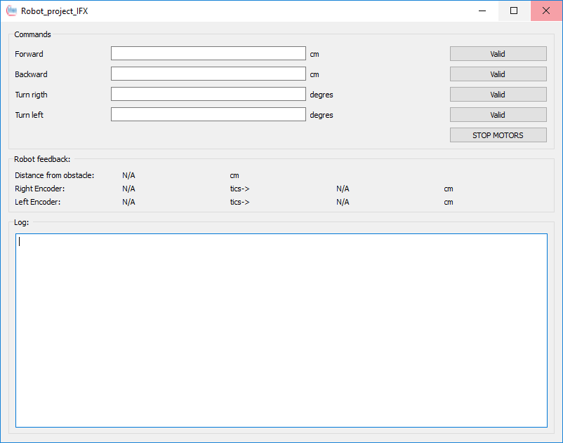
The GUI – First Look
Notes:
Add Keyboard command of the robot’s movements
Receive and display sensor data
Adjust Infineon logo and adjust the size of text field
Other Code related improvement were discussed with Virgile

Slide 8
Substaks: Maxime, Camera detection
To Do
Finish the Wiki page
Boot script for the Raspberry
Done
The dataset for the training is done (with the classification for each of the 3800 photos)
Training done : 36h
Running the CNN on the Raspberry done
Bluetooth communication (Rasberry -> Aurix Master)
Class, distance and angle of Detection for each target is sent to the Aurix in real time (1.5 fps)
Deadline : Second week of January (after Holidays)

Slide 9
Demonstration of the CNN

Slide 10
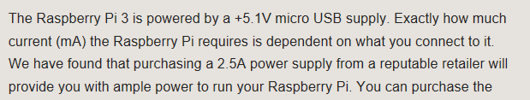
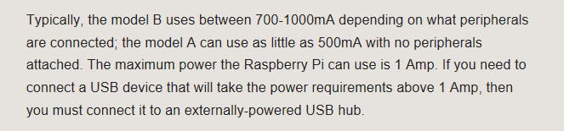
How to supply the Raspberry Pi ?
It uses a 5V and 2.5A micro USB
Typical current consumption between 700mA and 1A (we are probably over 1A)
Possible option: Power Bank ? The robot will be heavier.

Slide 11
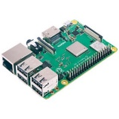
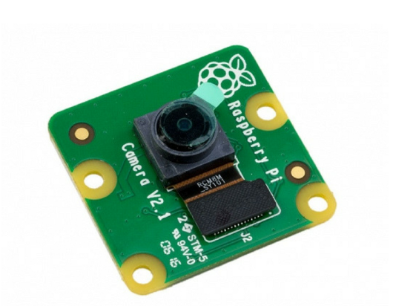
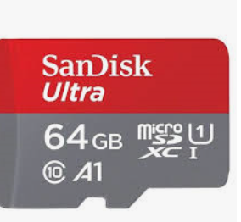
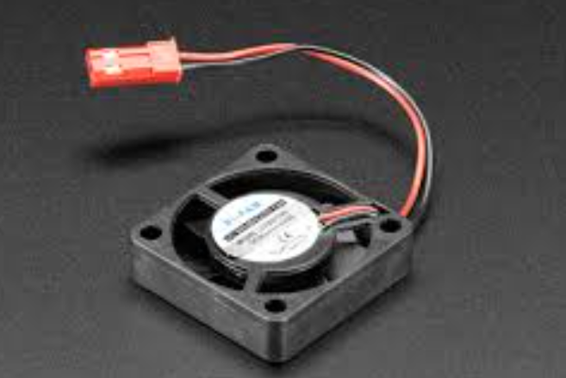
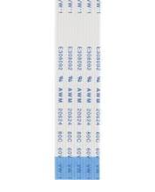
New Equipment Order
Last time we did not take into consideration the Camera related equipment because it was not expected that the equipment we had was not suited to developping the CNN
Raspberry Pi 3B+
Pi Camera 8MP
MicroSD card 64Go min
Air cooling system for Raspberry
Extension cable for the Camera
PowerBank to supply the Raspberry

